Slide 1
DSA
Lecture#6

Slide 2
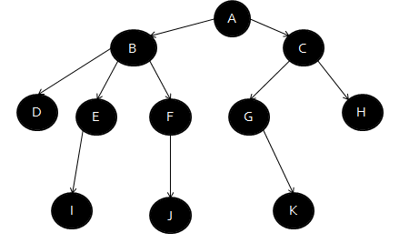
Non linear Data Structure
Tree
It is a nonlinear and hierarchical data structure.
Each node contains some data and also contain some link to other nodes

Slide 3
Tree
Root:
Topmost node of the tree. Only the node without parent
Child Node:
E.g., node A contains a link to node B then B is a child node of A
Parent Node:
A is parent of B in the above Example

Slide 4
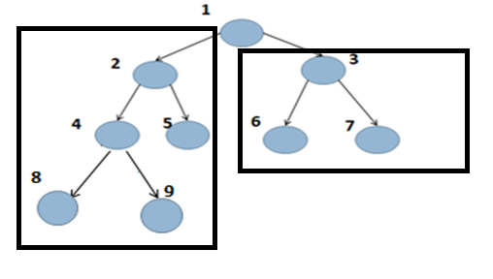
subtree
A tree is defined as a finite set of one or more data items(nodes), such that root node of the tree and the remaining nodes are partitioned into n>=0 disjoint subsets, each of which is itself a tree, and they are known as subtrees.

Slide 5
Tree (cont.)
Leaf Node:
Any node that does not have a child also known as terminal node
Sibling:
Parent of same child is called sibling

Slide 6
Tree (cont.)
Ancestors
Descendant

Slide 7
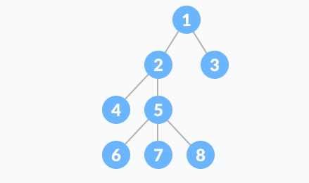
Degree of tree
The degree of a node is the number of connections that it has to other nodes in the tree.
Highest degree of the node among all nodes in the tree is the degree of tree.
Node 5 has highest degree i.e. 3 than other nodes
Thus, the degree of the tree is also 3.
Leaf nodes having degree 0.

Slide 8
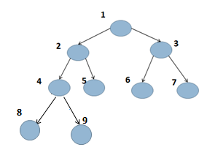
Level number
Root node having level 0.
Node 2 and 3 having level 1 and so on.
There are 4 levels in the three.
0,1,2 and 3.

Slide 9
generation
Level 0 is the first generation
Level 1 is the second generation and so on.

Slide 10
Properties of Tree
Path :
Edges from one node to another node
E.g., A to E from up to downward only.
Branch:
Edges from one node to another leaf node.
The highest branch having 4 nodes.
Number of nodes in the largest branch is the
height or depth of the tree.

